Slide 1
React JS
Alind Kumar Jain - 326835
Shilpa Mandara - 716650

Slide 2
Course Objectives:
At the end this six hours course, you will be able to -
Interpret React JS
Demonstrate Installation and configuration of ReactJS
Illustrate React Components
Summarize Props and State of components
Demonstrate Component lifecycle methods
Articulate Events
Develop React components and screens
Write Navigation to the React application
through answering the quiz correctly at the end of the session.

Slide 3
Introduction: What is React JS?
React is a Javascript library for building user interfaces
Developed by Facebook
Why ReactJS?
Curbs complexity of two-way data binding
Re-rendering of DOM tree
Dynamic data updates on page like API Calls, business logic etc.
Component based approach
Helps to build complex UI architecture like Facebook

Slide 4
Who will be Benefitted ?
Associates
Management

Slide 5
Key Topics
What is ReactJS?
Installation
Components
Props and State
Styling React Component
Component Lifecycle Methods
Event Handling
Keys and List
Routing
Hooks

Slide 6
In the next 6 hours , we will understand the basic concepts of React JS .

Slide 7








Who uses React ??

Slide 8
Features of React
Virtual Document Object Model (DOM)
One way data binding
Use of JSX
Composition of Components

Slide 9
What is Virtual DOM ?
Virtual DOM is an in-memory representation of Real DOM. It is a lightweight JavaScript object which is copy of Real DOM.
It has the same properties as a real DOM object, but it lacks the power to directly change what’s on the screen.
Manipulating the DOM is slow. Manipulating the virtual DOM is much faster, because nothing gets drawn onscreen.
DOM
Virtual DOM
Diff
Updated Virtual DOM

Slide 10
How does Virtual DOM work ? – ‘Reconciliation’
Real DOM
The entire virtual DOM gets updated.
The virtual DOM gets compared to what it looked like before you updated it. React figures out which objects have changed using the ‘diff’ algorithm.
Only the changed objects get updated on the real DOM.
Changes on the real DOM cause the screen to change
Model
Patch
Diff
DOM
In-memory DOM

Slide 11
How does Virtual DOM make React faster ?
Efficient diff algorithm
Batched update operations
Efficient update of sub tree only
Uses observable instead of dirty checking to detect change

Slide 12
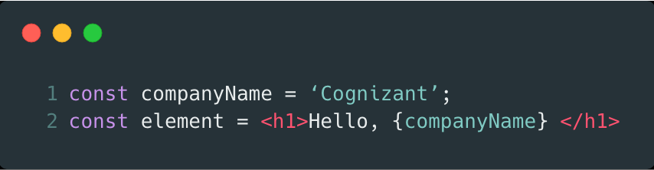
What is JSX ? - JSX produces React “elements”
JSX is an inline markup that looks like HTML and gets transformed to JavaScript and is used to create React elements. These elements are then rendered to the React DOM. A JSX expression starts with an HTML-like open tag, and ends with the corresponding closing tag.

Slide 13
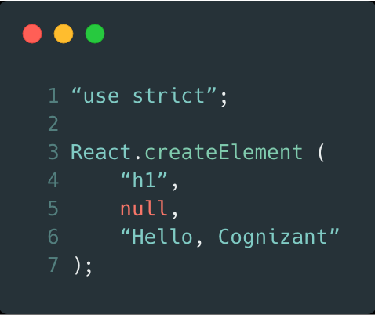
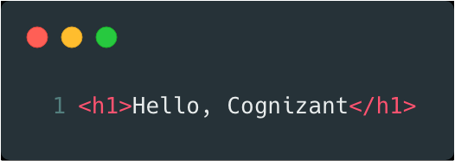
Fundamentally, JSX just provides syntactic sugar for the React.createElement(component, props, ...children) function. Behind the scenes, Babel (preprocessor) transpiles our code into a code which can be recognized by React to create Objects that can be used to construct the DOM

Slide 14
How does JSX benefit ?
It is faster than normal JavaScript as it performs optimizations while translating to regular JavaScript.
It makes easier for us to create templates.
Instead of separating the markup and logic in separated files, React uses components for this purpose. We will learn about components in details in further articles.

Slide 15
One way data binding
React apps are organized as a series of nested components. These components are functional in nature: that is, they receive information through arguments (the props) and pass information via their return values (the return value of the render function).
This is called unidirectional data flow.
Data is passed down from components to their children via props.
Parent
Emit Events
Pass
Props
Child

Slide 16
How does Unidirectional Flow of data benefit ?
Data flows throughout the app in a single direction, hence the developers have a better understanding and control over it.
Data flows in one direction after some change. This makes it easy to identify the source of the change, and then follow that change as it moves through your system.

Slide 17
Composition of Components
Everything in React is a component, and it follows a strong component based model promoting code reuse.
An app composed of many small parts is more manageable than a single large monolith app.
<App />
<MenuBar />
<MainPage />
<ListItem />
<ListItem />
<ListItem />
<SiteFooter />

Slide 18
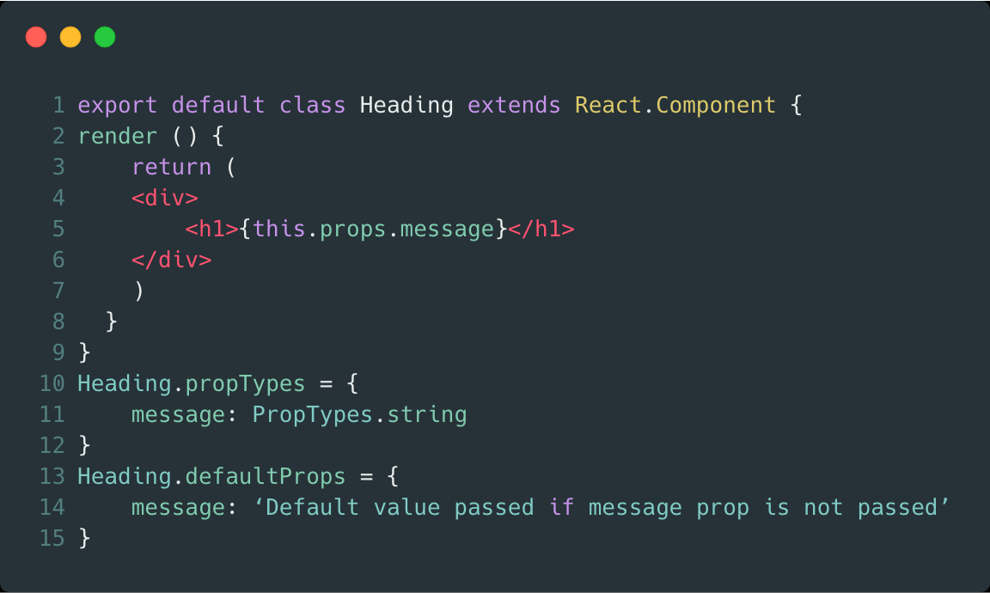
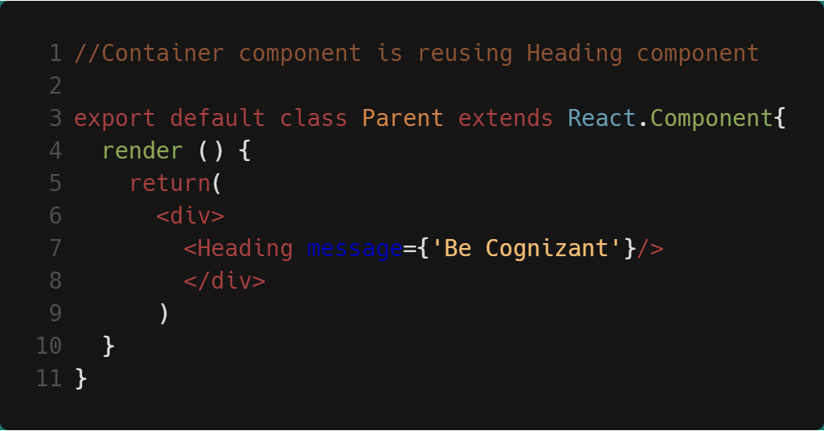
Creating a component
Features of React
Reusing the component
Now Heading component can be used by other components.

Slide 19
React JS Installation

Slide 20
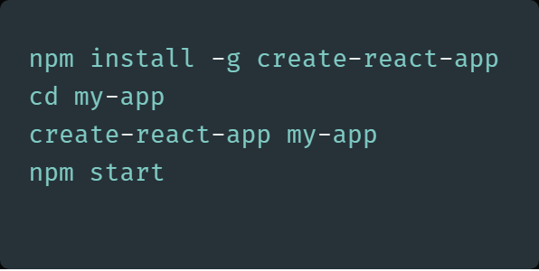
React JS Installation:
Online code playgrounds:
CodePen
CodeSandbox
Glitch
Setup Scenario 1:
Step 1: Download NodeJS
Step 2: Download the ‘create-react-app’ Tool from Git Hub
Step 3: Open cmd prompt and navigate to the project directory

Slide 21
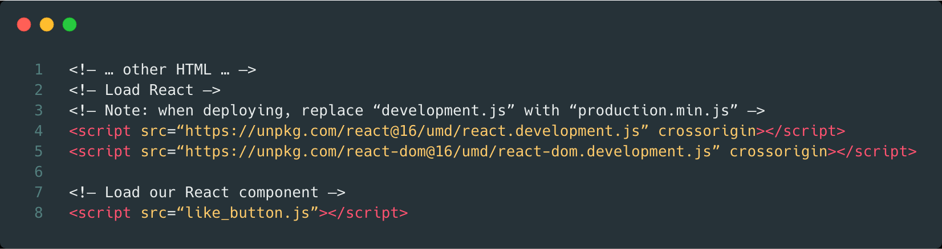
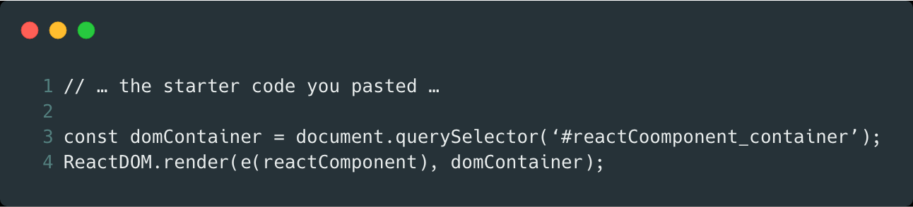
Setup Scenario 2:
Step 1: Add a DOM Container to the HTML
Step 2: Add the Script Tags
Step 3: Create a React Component

Slide 22
Recommended Toolchains
The React team primarily recommends these solutions:
Learning React or creating a new single-page app - use Create React App.
Server-rendered website with Node.js - Next.js.
Static content-oriented website - Gatsby.
Component library or integrating with an existing codebase - More Flexible Toolchains.

Slide 23
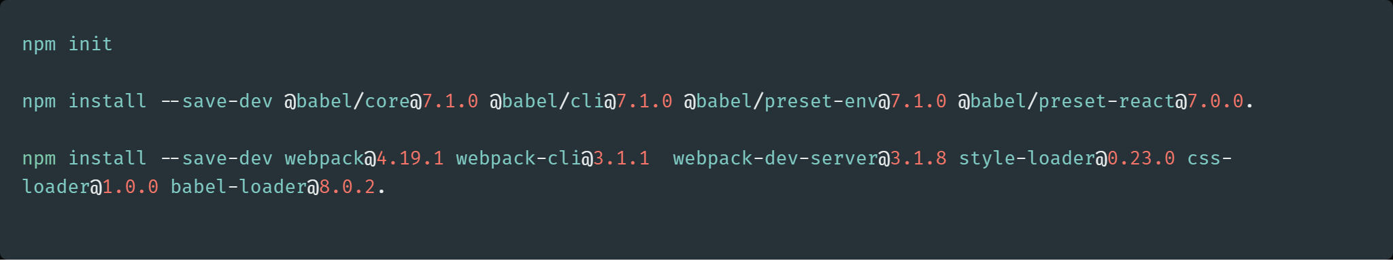
Creating a Toolchain from Scratch
A package manager, such as Yarn or npm lets you take advantage of a vast ecosystem of third-party packages, and easily install or update them.
A bundler, such as webpack or Parcel lets you write modular code and bundle it together into small packages to optimize load time.
A compiler such as Babel lets you write modern JavaScript code that still works in older browsers.

Slide 24
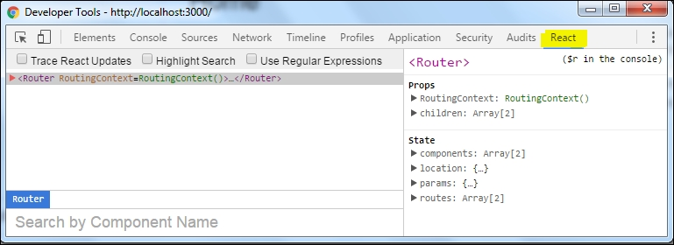
React developer add-on tool
ReactJS Debugging tool allows us to inspect a React-rendered component with the component hierarchy, props, and state.
Open the Developer Tools on a React page. You should see one extra tab called React

Slide 25
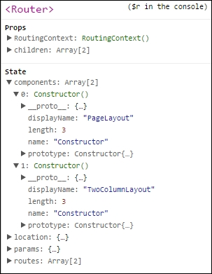
In the side panel, you can see the State and Props for every React component.
If you expand the State , you will see the full hierarchy of that component in React app.

Slide 26
Components in React JS
Components are the building blocks of any React app and a typical React app will have many of these.

Slide 27
Component
A component is a JavaScript class or function that optionally accepts inputs i.e. properties (props) and returns a React element (DOM) that describes how a section of the UI should appear.
Props
Component
DOM

Slide 28
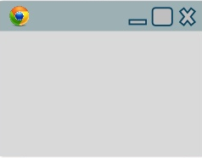
An application's UI can be split up into smaller components where each component has its own code, structure
< App />
<one/>
<Four/>
<Two/>
<Five/>
<Three/>
<Six/>

Slide 29
All these components can be integrated together to build one application.
These components can be easily updated without disturbing rest of Application.
<Six/>
<Four/>
<one/>
<Two/>
<Five/>
<Three/>

Slide 30


Components in React basically returns a piece of JSX code which tells what should be rendered on the screen. In React mainly there are two types of components:
Functional Components
Class Components
Component
Functional
Class

Slide 31
Functional Component
These components are simply represented by a JavaScript function that optionally takes parameters (props) and returns a React element to be rendered to the page.
function FunctionalComponent()
{
return <h1> Hello World </h1>
}
Props
DOM
Since, Functional Component simply return a React Element , they are predictable and concise.

Slide 32
Functional components are also referred to as stateless, dumb or presentational in other literature. All these names are derived from the simple nature that functional components take on.
Functional because they are basically functions
Stateless because they do not hold and/or manage state
Presentational because all they do is output UI elements
Since, they are purely presentational, their output is always the same given the same props.

Slide 33
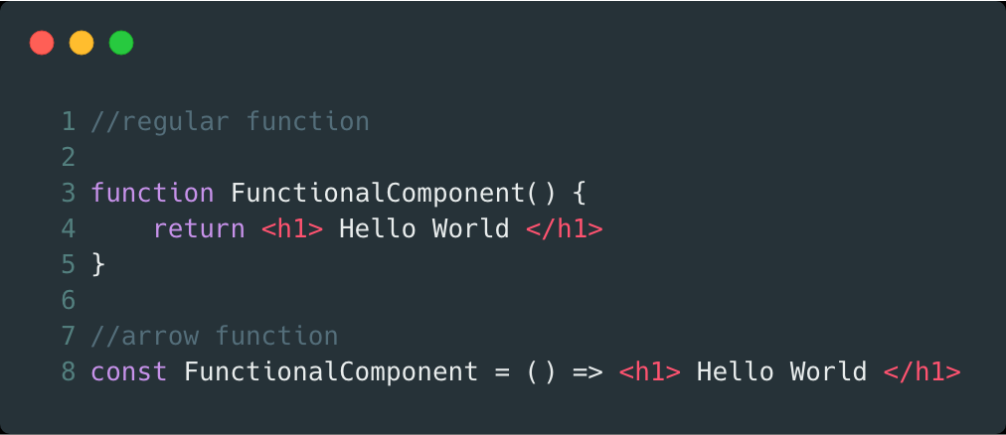
There are two ways that you can create a functional component. The traditional way is to use regular JavaScript function. ES6 introduced a syntax sugar that allows developers to write arrow functions(without function and return keyword)

Slide 34
Class Components
Class Components are little more complex than the functional components. The
functional components are not aware about the other components in program where as the class components can work with each other by passing data (Props) from one class component to other class component.
These components are created using ES6’s class syntax. They have some additional features such as the ability to contain logic (for example methods that handle onClick events), local state.

Slide 35
Class components are referred to as smart, stateful, container components.
Class because they are basically classes
Smart because they can contain logic
Stateful because they can hold and/or manage local state
Container because they usually hold/contain numerous other (mostly functional) components

Slide 36
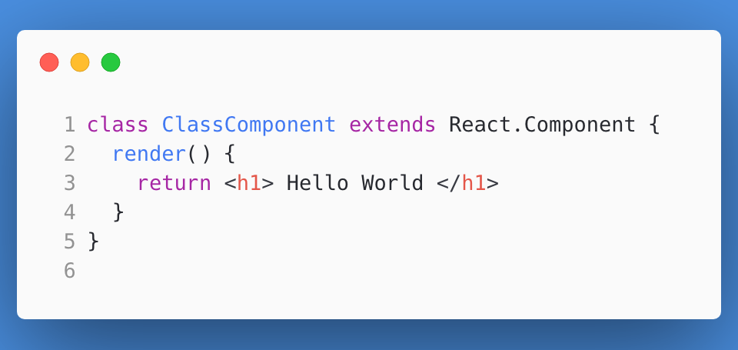

A class component in its simplest form:
When naming a React component, it is convention to capitalize the first letter. This is important because it enables React to differentiate between the native HTML tags such as div, h1, span etc and custom components like ClassComponent.

Slide 37
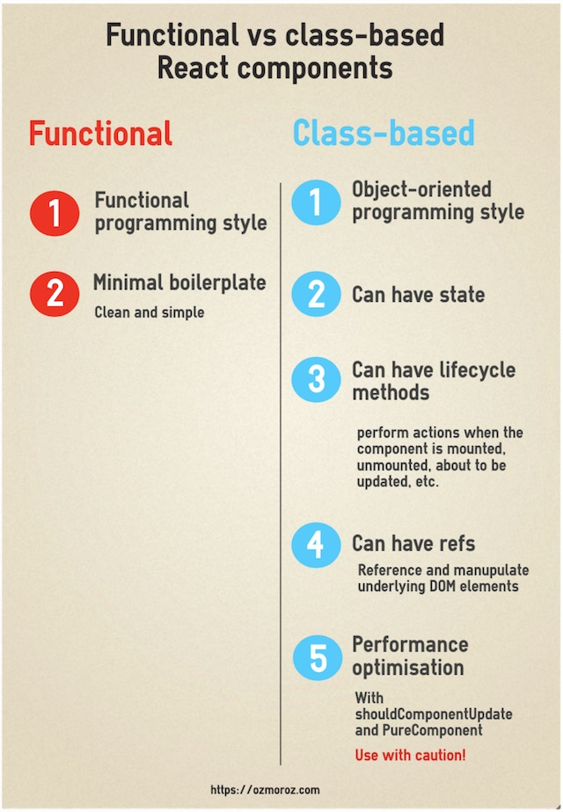
Which type of component to use?
It’s important to know whether to use class or functional components.
Use a class component if you:
need to write complex logic using local state
need to add lifecycle methods to your component
need to add logic for event handlers
Otherwise, always use a functional component.
Class components that only have markup within the render body can safely be converted to functional components.

Slide 38

Practice Check
What is React JS?
Server side Framework
User-interface framework
A Library for building interaction interfaces
2. What are the advantages of React JS?
React can be used on client and as well as server side too
Using React increases readability and makes maintainability easier. Component, Data patterns improves readability and thus makes it easier for maintaining larger apps
React can be used with any other framework (Backbone.js, Angular.js) as it is only a view layer
All of the above

Slide 39
Practice Check
3. React considers everything as _____________
Module
Component
Package
Class
4. How many elements does a react component return?
2 Elements
1 Element
Multiple Elements
5. What is Babel?
A transpiler.
An interpreter
A Compiler
Both Compiler and Transpiler

Slide 40
State & Props

Slide 41
Quick recap what we learned till now ….
Understand ReactJS
Install and configure ReactJS
Work with React Components

Slide 42
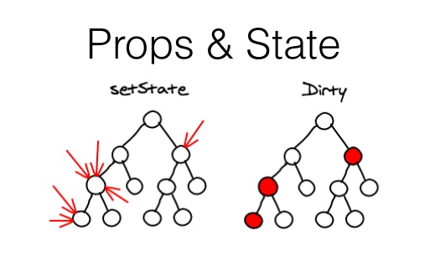

Slide 43
State
State of an instance of a React Component Class can be defined as an object of a set of observable properties that control the behavior of the component.
In other words, State of a component is an object that holds some information that may change over the lifetime of the component.

Slide 44
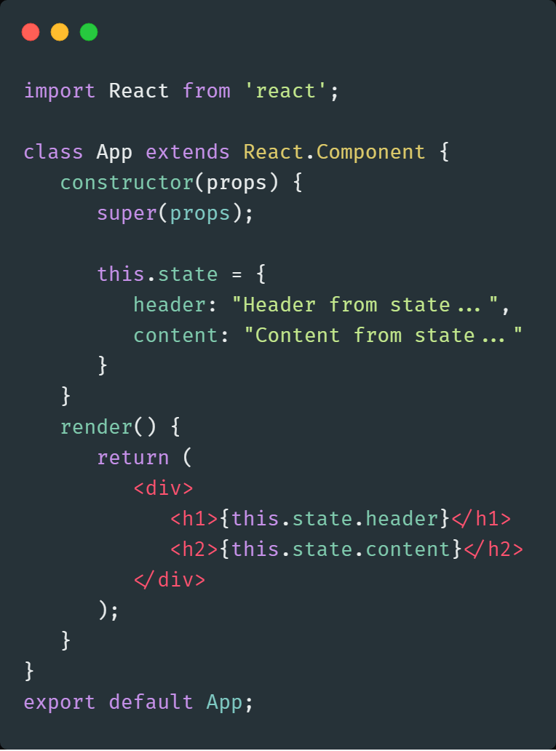
State Initialization
Accessing state

Slide 45

Conventions while Using State

Slide 46
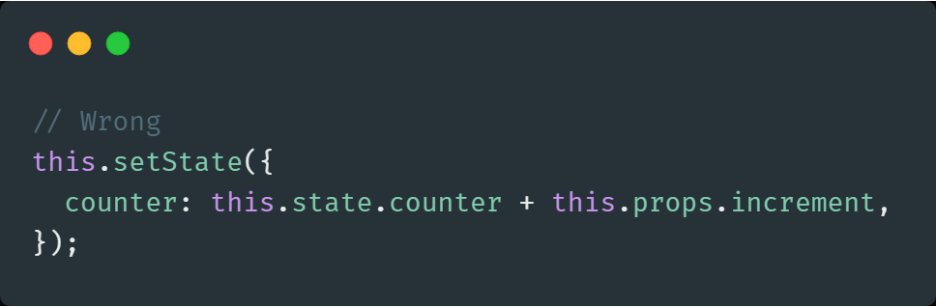
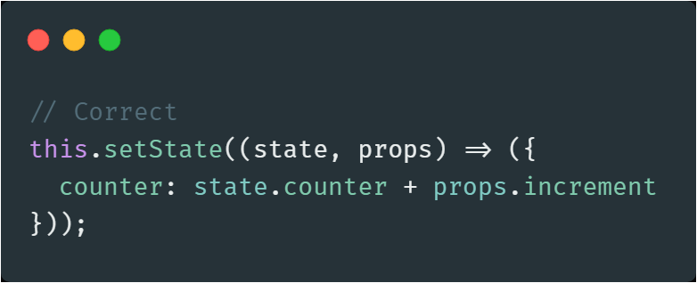
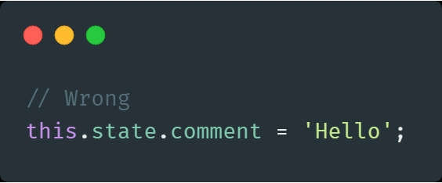
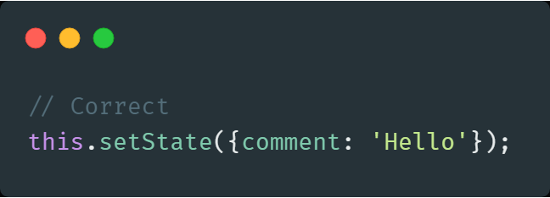
State Updates May Be Asynchronous
React may batch multiple setState() calls into a single update for performance.
Since this.props and this.state may be updated asynchronously, you should not rely on their values for calculating the next state.
Do Not Modify State Directly instead use

Slide 47
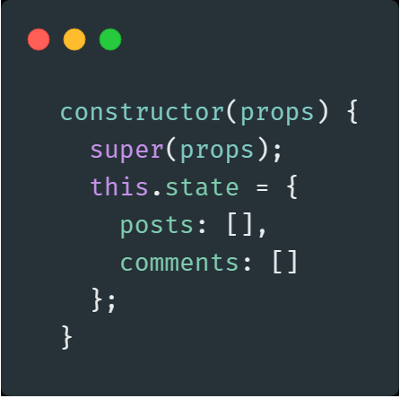
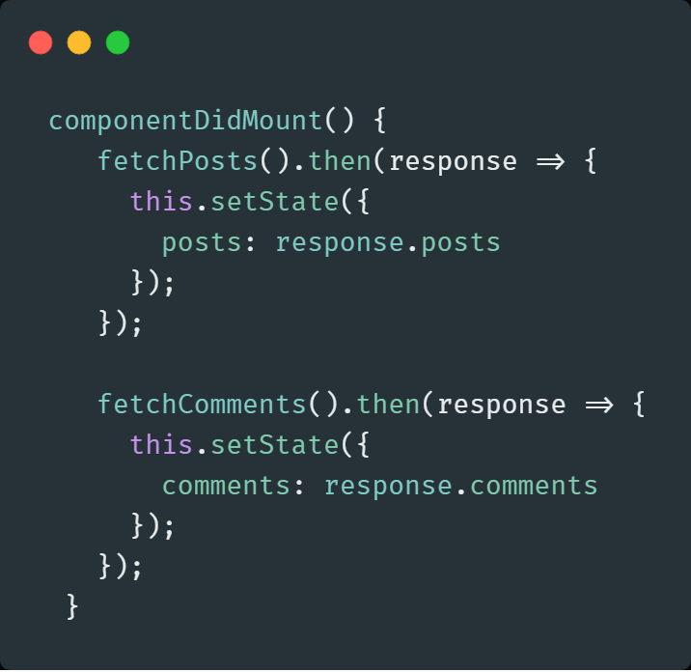
State Updates are Merged - When you call setState(), React merges the object you provide into the current state.

Slide 48
Props
A component may choose to pass its state down as props to its child components.
This is commonly called a “top-down” or “unidirectional” data flow. Any state is always owned by some specific component, and any data or UI derived from that state can only affect components “below” them in the tree.
If you imagine a component tree as a waterfall of props, each component’s state is like an additional water source that joins it at an arbitrary point but also flows down.

Slide 49


Difference between Props and State
ReactJS: Props vs. State
Props are immutable i.e. once set the props cannot be changed, while State is an observable object that is to be used to hold data that may change over time and to control the behavior after each change.
States can only be used in Class Components while Props don’t have this limitation.
While Props are set by the parent component, State is generally updated by event handlers.
Props
<Component />
State
Props
Props
<Component />
<Component />
State
State

Slide 50
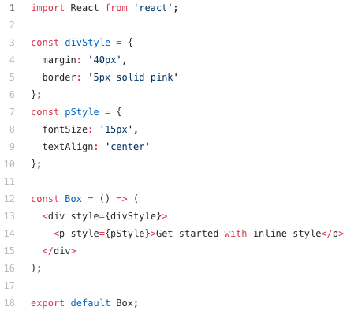
Styling in react component
CSS Stylesheet
Inline styling
CSS Modules
Styled-components

Slide 51
Practice Check
State updates can be merged by passing in an object to setState()?
True
False
None
Let there is <Clock /> component used as: <Clock currentTime=’12:01pm' />
How would you access the value 12:01pm from inside the component?
Clock.currentTime
currentTime
this.currentTime
this.props.currentTime
What is true about state in React? Please select all that apply:
A component's state can be defined at initialization
State is usually passed in from outside components
State should be used when you want to store information that will never change
A component can alter its own internal state

Slide 52
Component Lifecycle Methods

Slide 53

Component Lifecycle Methods

Slide 54
Component Lifecycle
In applications with many components, it’s very important to free up resources taken by the components when they are destroyed.
We can declare special methods on the component class to run some code when a component mounts and unmounts. These methods are called “lifecycle methods”.

Slide 55
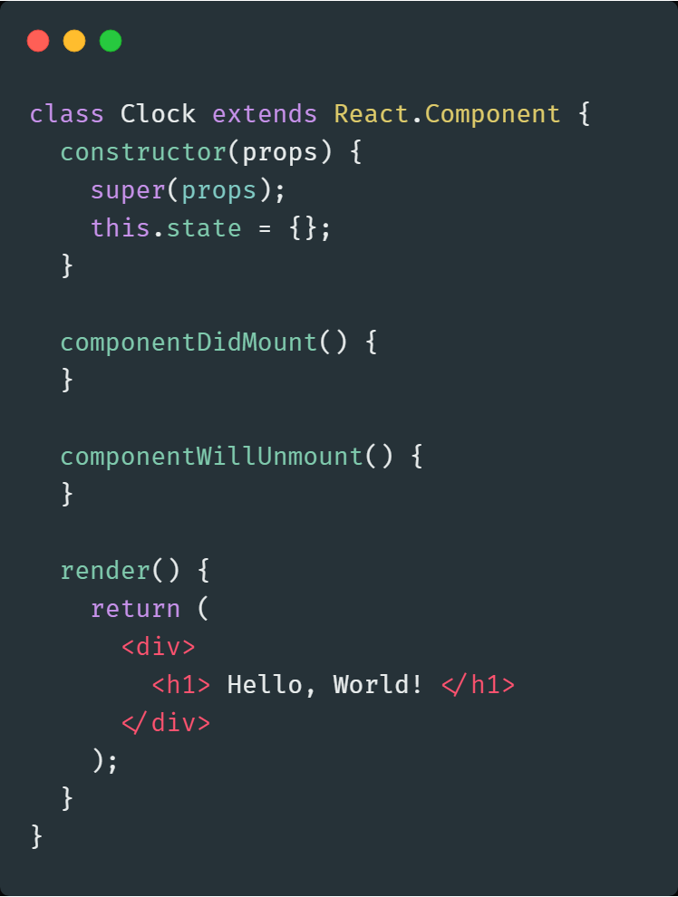
Component Lifecycle Methods
Constructor
ComponentWillMount
ComponentDidMount
ComponentWillReceiveProps
ShouldComponentUpdate
ComponentWillUpdate
ComponentDidUpdate
ComponentWillUnmount

Slide 56
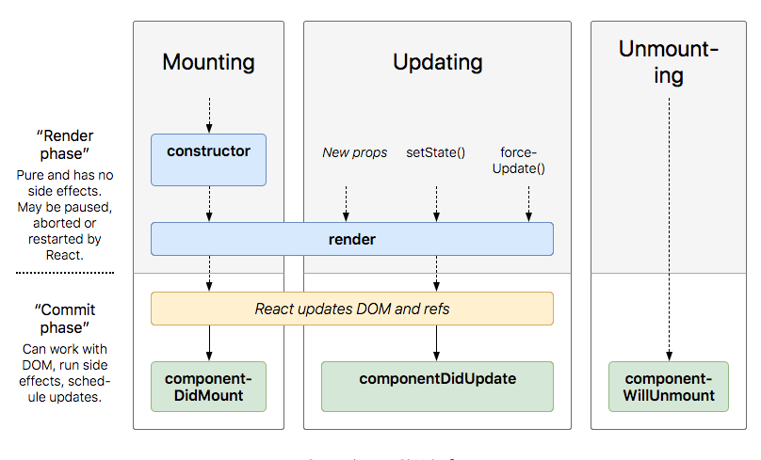

Slide 57
Commonly Used Lifecycle Methods
Constructor - It is called before component is mounted. Typically, in React constructors are only used for two purposes:
Binding event handler methods to an instance
Initializing local state by assigning an object to this.state.
ComponentDidMount() - Invoked immediately after a component is mounted.
Initialization that requires DOM nodes should go here.
Its a good place to set up any subscriptions. If you do that, don’t forget to unsubscribe in componentWillUnmount().

Slide 58
ComponentDidUpdate()
Invoked immediately after updating occurs.
This is also a good place to do network requests.
ComponentWillUnmount()
Invoked immediately before a component is unmounted and destroyed. .
Perform any necessary cleanup in this method, such as invalidating timers, canceling network requests, or cleaning up any subscriptions that were created in componentDidMount().

Slide 59
Rarely Used Lifecycle Methods
shouldComponentUpdate()
Static getDerivedStateFromProps()
getSnapshotBeforeUpdate()
Legacy Lifecycle Methods
UNSAFE_componentWillMount()
UNSAFE_componentWillReceiveProps()
UNSAFE_componentWillUpdate()

Slide 60
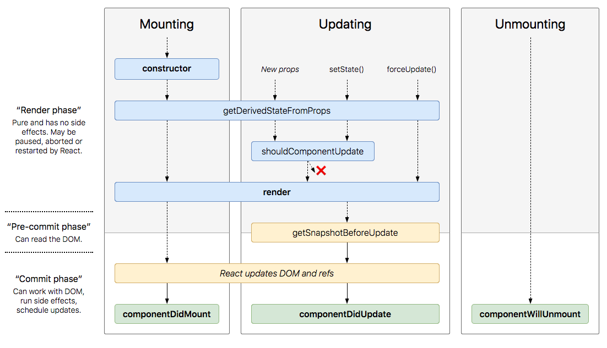

Slide 61
New Component Lifecycle
Mounting
A component is generally mounted when its first created and implanted into the DOM. It usually takes place when it is rendered for the first time.
Updating
An update can be caused by changes to props or state
Unmounting
This method is called when a component is being removed from the DOM
Error Handling
These methods are called when there is an error during rendering, in a lifecycle method, or in the constructor of any child component.

Slide 62
New Component Lifecycle (Contd..)
Mounting
constructor(), static getDerivedStateFromProps(), render(), componentDidMount()
Updating
static getDerivedStateFromProps(), shouldComponentUpdate(), render(), getSnapshotBeforeUpdate(), componentDidUpdate()
Unmounting
componentWillUnmount()
Error Handling
static getDerivedStateFromError(), componentDidCatch()

Slide 63
Event Handling
Events are named using camelCase instead of just using the lowercase. i.e. onSubmit, onChange etc.
Events are passed as functions instead of strings.
Events are the triggered reactions to specific actions like mouse hover, mouse click, key press, etc.
Handling these events are similar to handling events in DOM elements.
Event are either to be bind as arrow function i.e. ()=>{} to bind the context of this or should be bind in constructor of the component.
Event propagation is not stopped automatically. It has to be triggered appropriately. i.e. – onSubmit a form will make an actual submit if not stop.

Slide 64
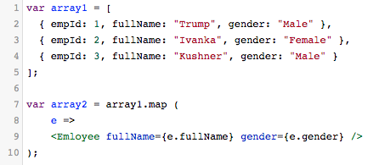
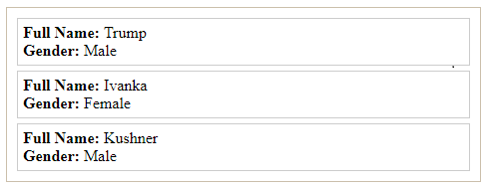
In JavaScript, you want to create a new array from an available array by converting each element of the original array to create the corresponding element of the new array, you can use map() method. For example, you have an array of integer numbers, such as [1, 2, 5], and you want to create another array by multiplying each element of the initial array by 10.
List and Keys

Slide 65
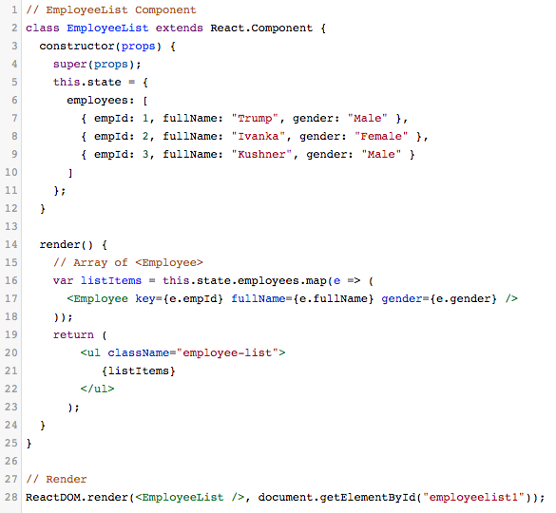
Keys helps React distinguish items in a list. It helps the React manage the changed items, new items added, or items removed from the list. From an array of objects, you create a new array containing tags, which should have the key attribute, and their values are not allowed to be the same.
Keys

Slide 66
Practice Check
Which method in a React Component is called after the component is rendered for the first time?
componentDidUpdate
componentDidMount
componentMounted
componentUpdated
Which of the following mounting methods are invoked before the component is inserted into DOM?
getInitialState
componentDidMount
componentWillMount
componentWillUnmount
React Lifecycle method static getDerivedSateFromProps(props , state) is called when…
Component is created for the first time
State of the component is updated
Both of above
None of above

Slide 67
Routing in React JS

Slide 68
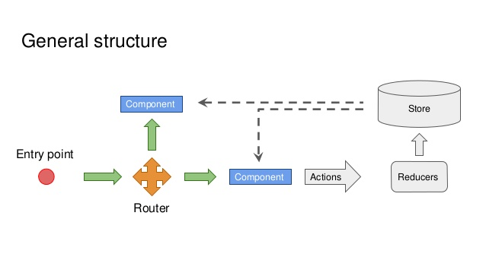
ROUTING
Routing or Navigation, is an integral and important part of any application.
It gives us the power of navigating from one page or screen to another.
This power is provided by React as well.
There are many ways for routing provided by React.
But the most important and used one is , REACT ROUTER.

Slide 69
Single Page Applications(SPA)
Web application or Web site that interacts with the user by dynamically rewriting the current page rather than loading entire new pages from a server.
So basically, all the code resources are dynamically loaded and added to the page as necessary, usually in response to user actions.
Route Config
External
Navigation
Location
Content
Browser History
Router
View
Internal Navigation

Slide 70
React Router
Since we are dealing with a SPA, you need a way to trigger the contents that are loaded on the screen.
React Router introduces a concept called “Dynamic Routing”, which is quite different from “Static Routing” .
When dealing with “Static Routing”, declare routes as part of app’s initialization before any rendering takes place (Rails, Express, Ember, Angular, and so on).
“Dynamic Routing” means that routing takes place as app is rendering, not in a configuration or convention outside of a running app.

Slide 71
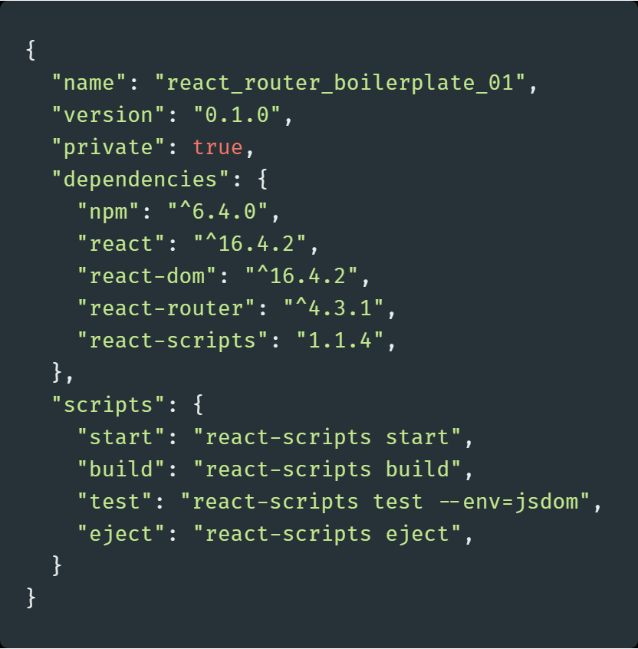
Setting Up React Router
Step-1
Install dependency
$ npm i -S react-router
or
$ yarn add react-router
After running either of these commands
react-router will be added to your package.json file

Slide 72
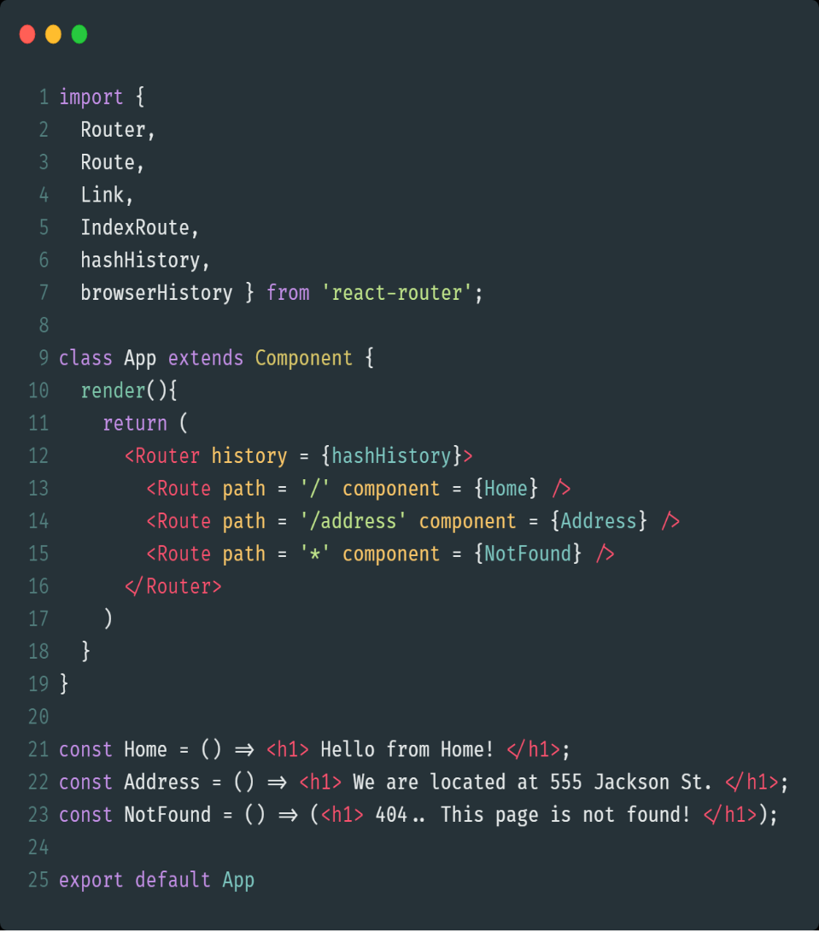
Routing Components
Router will wrap all of the routes we are going to define.
Each route will be identified in a <Route> component.
The <Route> component will take two properties: path and component.
When a path matches the path given to the <Route> component, it will return the component specified.

Slide 73
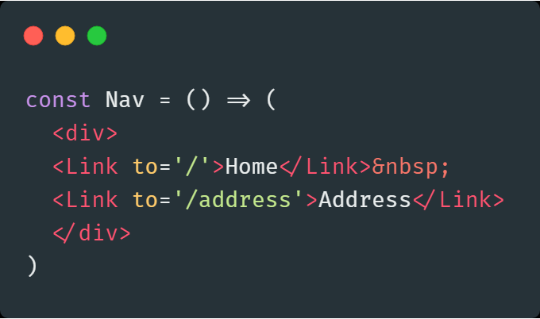
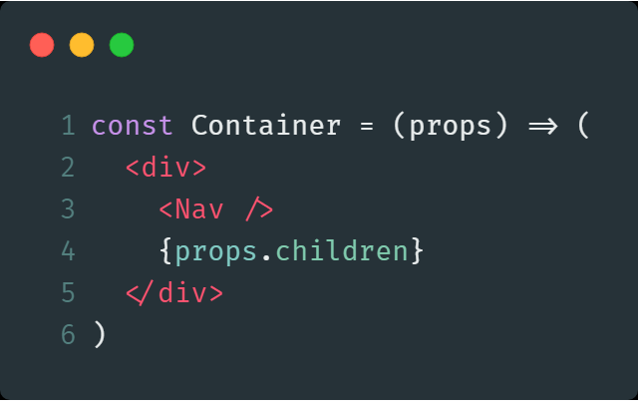
Routing Components(Contd.)
Now to make our Nav component persistent across all pages. Wrap child routes in a main <Route> component.
Update Home component, and create a new component called Container {props.children} will allow any routes wrapped within this route to be rendered in this component
To add navigation, use <Link>
To do this, let’s first create a Nav component. Our Nav component will contain <Link> components

Slide 74
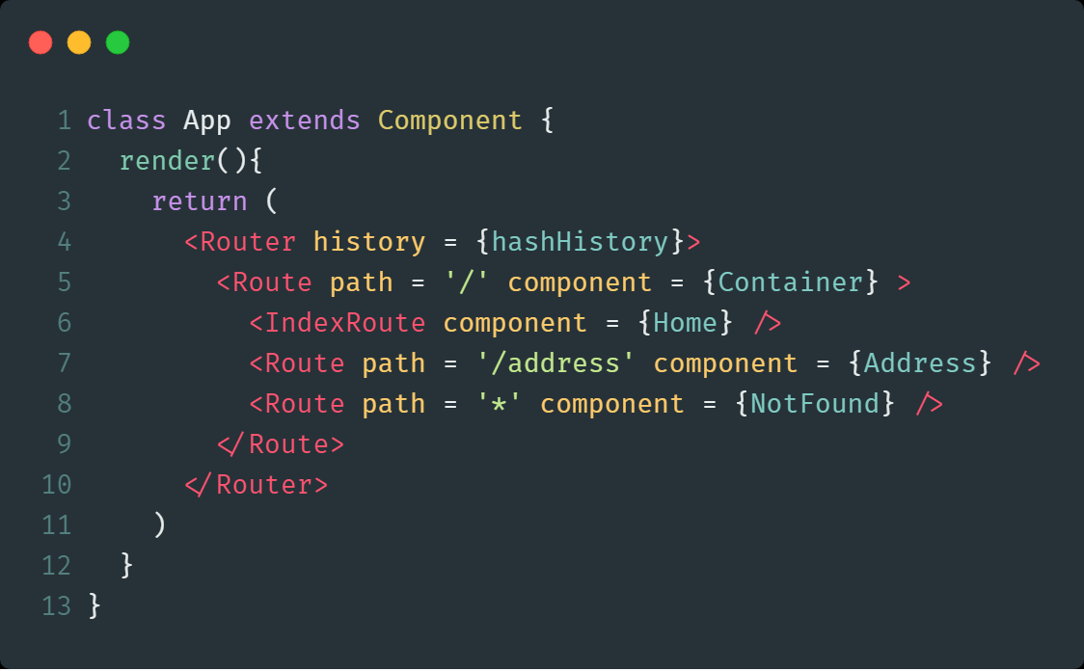
Routing Components(Contd.)
Wrap HomePage, Address and NotFound routes inside the new Container route.
Set HomePage to be IndexRoute.

Slide 75
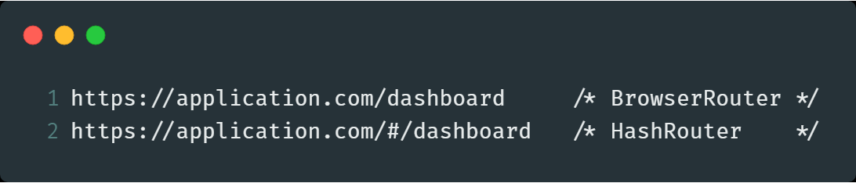
<HashRouter> Vs <BrowserRouter>
One builds classic URLs, the other builds URLs with the hash,as shown.
Which one to use basically depends on, which browser is in action.
<BrowserRouter> uses History API, which is not supported by IE9 and below.
The History API lets you interact with the browser history, trigger the browser navigation methods and change the address bar content.

Slide 76
Recap Of Routing
Routing is an important part of any application.
There are many routers available to be used with React.
Important one is React Router.
It helps us to create Single Page Applications with dynamic Routing.
Install react-router library to render it’s functionality.
<Router> contains all the routes, defined by <Route>
When a path matches path of <Route>, it returns the component.
<Link> provides navigation.
<HashRouter> contains classic URLs with hash.
<BroserRouter> uses History API.

Slide 77
Practice Check
__________ means that routing takes place as app is rendering ?
Static Routing
React Routing
Dynamic Routing
None of the above
Name the properties that <Route > component takes:
to , component
pathname, to
to , render
path, component
Which component wraps all of the routes in react app using react-router?
<Link>
<Route>
<Nav>
<Router>

Slide 78
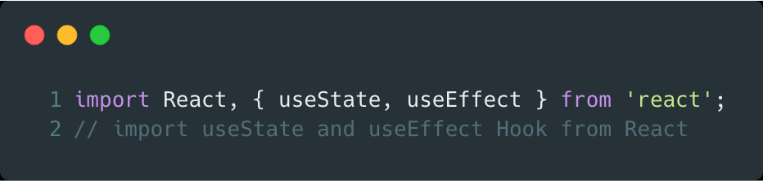
Hooks
Hooks are special functions that let you “hook into” React state and lifecycle features from function components. Hooks don’t work inside classes — they let you use React without classes.
There are primarily two types of Hooks :
State Hook - useState
Effect Hook - useEffect

Slide 79
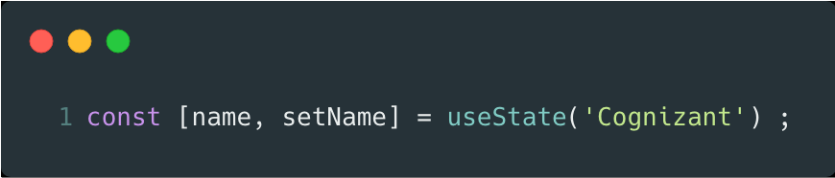
State Hook
useState is a Hook that lets you add local state to function components.
React will preserve this state between re-renders
The useState function returns a pair :
Current state value
Function that lets you update the value
The useState takes only one argument :
The initial state
Declaring a local state variable
New state variable
Function to change the variable
Initial state value for the variable

Slide 80
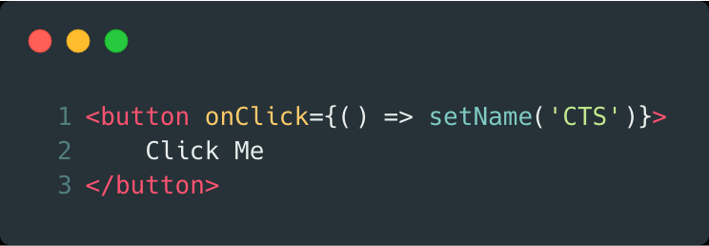
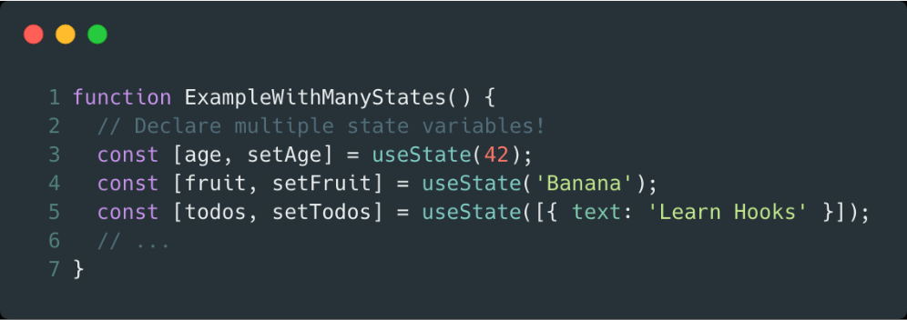
In our example, the setName function that we declared is similar to the this.setState in a class . It will be called to change the local state from event Handles .
The state hook can be used more than once in a single component to declare multiple state variables.

Slide 81
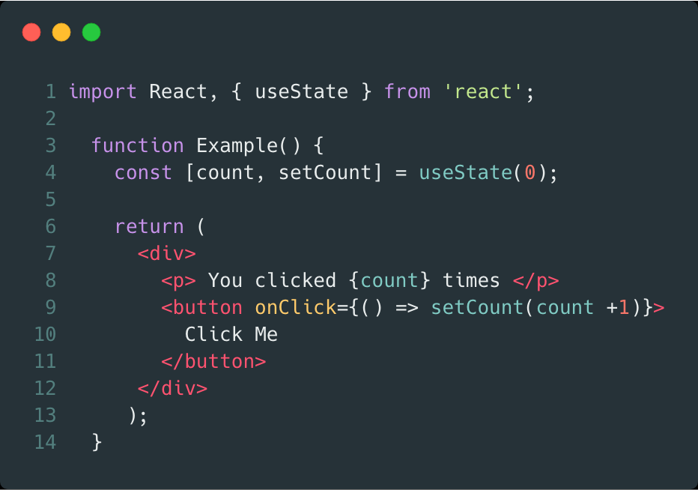
Here is an example of a functional component that uses state hook to add a local state.
Count variable is declared at line 4 with an initial value of 0.
Count variable is accessed at line 8
setCount is called at line 9 to increase the count by 1 .

Slide 82
Effect Hook
Picture this: you have a perfectly good function component, and then one day, you need to add a lifecycle method to it.
Converting the function component to a class component and adding the lifecycle methods was the logical solution before useEffect Hook was introduced.
useEffect, allows us to handle lifecycle events directly inside function components. Namely, three of them: componentDidMount, componentDidUpdate, and componentWillUnmount. All with one function!

Slide 83
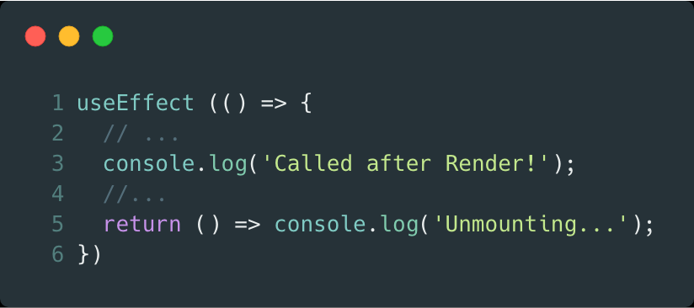
useEffect takes a single argument : function
These are declared inside the component so they have access to its props and state. By default, React runs the effects after every render — including the first render.
When you call useEffect, you’re telling React to run your “effect” function after flushing changes to the DOM.
Cleanup Function
If a function is returned , React will call it prior to unmounting similar to componentWillUnmount.
It will also be called every time before that effect runs – to clean up from the last run

Slide 84
Rules of Hooks
Only call Hooks at the top level. Don’t call Hooks inside loops, conditions, or nested functions.
Only call Hooks from React function components. Don’t call Hooks from regular JavaScript functions.

Slide 85
Practice Check
Functional components can have their local state with help of Hooks?
True
False
None
Which hook is used to manage side effects using life cycle methods?
useState( )
useEffect( )
useContext( )
None of the above

Slide 86
Quiz
Which method in a React Component should you override to stop the component from updating?
willComponentUpdate
shouldComponentUpdate
componentDidUpdate
componentDidMount
What's used to pass data to a component from outside?
set State
render with arguments
Prop Types
Props
Which method in a React Component is called after the component is rendered for the first time?
componentDidUpdate
componentDidMount
componentMounted
componentUpdated

Slide 87
Quiz
Which of the following is correct syntax for a button click event handler, foo?
<button onclick={this.foo()}>
<button onclick={this.foo}>
<button onClick={this.foo()}>
<button onClick={this.foo}>
What happens when you call setState() inside render() method?
Repetitive output appears on the screen
Stack overflow error
Duplicate key error
Nothing happens. Life goes on!
How do you write an inline style specifying the font-size:12px and color:red; in JSX?
style={{font-size:12,color:'red'}}
style={{fontSize:'12px',color:'red'}}
style={fontSize:'12px',color:'red'}
style={{font-size:12px,color:'red'}}

Slide 88
Summary
React JS is JavaScript library used for building reusable UI components
JSX is JavaScript syntax extension. It isn't necessary to use JSX in React development, but it is recommended.
React JS implements one-way data flow which makes it easy to debug your app.
Props are immutable and are used to send data to components.
State is an internal data store (object) of a component and state updates are asynchronous .
Component lifecycle hooks are special methods which helps to perform changes in Component’s lifecycle.
Event are either to be bind as arrow function i.e. ()=>{} to bind the context of this or should be bind in constructor of the component.
Navigation is important part of any application, there are several routers available and we have understood React Router as part of this course

Slide 89
Thank You

